Slide 1
Introduction to Internet Operation

Slide 2



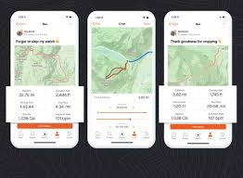


What is the internet?
User perspective:
Access to communication systems and services
Notes:
User perspective : access to huge number of services and communication systems (netflix, email, websites, telephony)

Slide 3
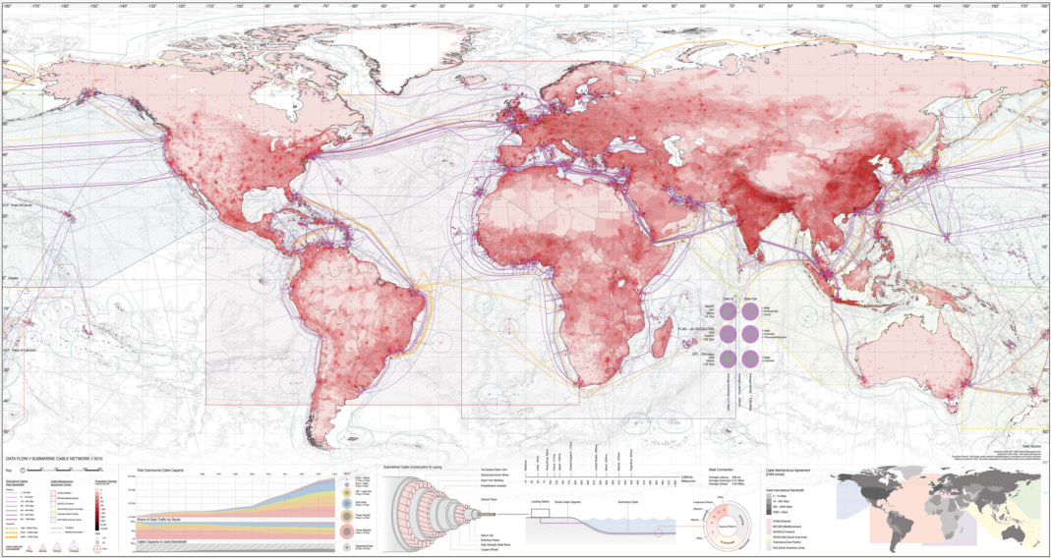
Internet is an infrastructure
Map of the world’s undersea cables by Ben Pollock
https://geoarchitecture.files.wordpress.com/2016/05/1400x1057_ben_s.jpg
Notes:
Is there anything interesting or surprising to you in this map?

Slide 4
What is the internet?
Computer science perspective:
Internet has the ability to reliably transfer data between remote computers
Its a fault-tolerant network of networks
A layered technology stack abstracts applications from the physical carrier
Connections are via technical ‘protocols’ based on ‘standards’, that enable different applications and different providers to use the same infrastructure
Notes:
CS/ Engineering perspective:
Ability to transfer data between remote computers
A fault-tolerant network of networks
Connected via technical ‘protocols’ based on ‘standards’
Layered technology stack
Lets take a quick look at each of these then we will get into more detail in the lab sessions.

Slide 5

Ability to transfer data between computers
The ‘client’ (the users computer) requests information held remotely.
Data is sent from the ‘server’ (the remote computer) back to the client in answer to their ‘request’
Software on the client computer (the browser) renders the data returned for the user to view
Example: viewing a web page
Notes:
Can someone talk me through what happens when someone loads a web page?

Slide 6
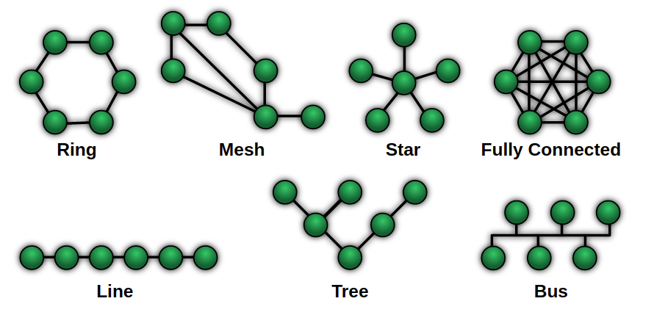
A fault-tolerant network of networks
The internet has a mesh ‘topology’. There are multiple possible routes from one node to another without requiring full interconnection between all nodes
The domain name system and routing protocols are the means by which data sources are found and routes round the network are discovered.
NetworkTopologies.png, Public Domain, https://commons.wikimedia.org/w/index.php?curid=15006915
Notes:
Whats wrong wtih the bus?
Whats wrong with the tree?
Whats wrong with ‘fully connected?’

Slide 7
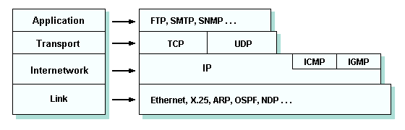
Layered technology stack
Notes:
Can someone describe what this is about?
Can you compare this to the operating systems ‘stack’?

Slide 8
Connected via technical ‘protocols’ based on ‘standards’
Agreed sets of rules by which communication takes place, so that systems can interoperate
Some ‘protocols’ you may have heard of:
http
https
ftp
smtp
sip
Notes:
The internet has been successful because different companies or organisations have been free to create their own software, services and products. But they have to conform to publically available standards. Adherence to the standards enables them to communicate with eachother.
Example may be an email client.
These can provide user interfaces in whatever way they like, or can provide services such as bulk mailing or automated mailing. What counts is that they use standard protocols to send and receive the data, address data to users, handle errors and other technical necessities
Likewise the http / https protocols for accessing web pages. These dictate the exact format of the request and response, without any concern for the content, or for the exact technical implementation of either the browser or the server. So, you an access any web page on any computer.

Slide 9
Protocols and handshakes
The TCP handshake establishes rules for communication when a computer attempts to communicate with another device
By Guojunzheng - Detailed example about the process of three way handshaking
CC BY-SA 3.0, https://commons.wikimedia.org/w/index.php?curid=24426758
Notes:
The ‘handshake’ is a metaphor from human behaviour.
How do you think the technological handshake is similar and different from, for example, a handshake when two diplomats meet eachother?

Slide 10

Common protocols and ports
Internet standards are proposed, amended and agreed via a transparent, community based process organised by the Internet Engineering Taskforce (IETF).
File Transfer Protocol (FTP) Data Transfer - Port 20
File Transfer Protocol (FTP) Command Control - Port 21
Secure Shell (SSH) - Port 22
Telnet - Remote login service, unencrypted text messages - Port 23
Simple Mail Transfer Protocol (SMTP) E-mail Routing - Port 25
Domain Name System (DNS) service - Port 53
Hypertext Transfer Protocol (HTTP) used in World Wide Web - Port 80
Post Office Protocol (POP3) used by e-mail clients to retrieve e-mail from a server - Port 110
Network News Transfer Protocol (NNTP) - Port 119
Network Time Protocol (NTP) - Port 123
Internet Message Access Protocol (IMAP) Management of Digital Mail - - Port 143
Simple Network Management Protocol (SNMP) - Port 161
Internet Relay Chat (IRC) - Port 194
HTTP Secure (HTTPS) HTTP over TLS/SSL - Port 443

